Slide 1


DOCONNECT
TEAM MEMBERS:
Batch- C1, Group- G7
DEVASHISH SINGH
PINNIBOINA YUVA ROHITH
MD FAIZAN KHAN
CHILUVERU UGANDAR VENKATA SAI KRISHNA
SHARANYA
MENTORED BY:
Javeed Mohammed Husnuddin

Slide 2
INDEX
Objective
Functional Requirement
Services
Project Overview
Architecture
Technologies & Tools Used
Implementation
Conclusion

Slide 3
OBJECTIVE
Build an Application(DoConnect) in which technical questions were asked and answered

Slide 4
Functional Requirements USER
As a user I should be able to login, Logout and Register into the application.
As a user I should be able to ask any question under any topic
As a user I should be able to search the question on any string written in search box
As a user I should be able to Answer any question asked
As a user I should be able to answer more than one question and more than one time

Slide 5
ADMIN
As an Admin I should be able to login, Logout and Register into the application.
As an Admin I should be able to get mail as soon as any new Question is asked or any Answers given.
As an Admin I should be able to approve the question and Answer. Any Question or Answer will be visible on the platform only if it is approved.
As an Admin I should be able to delete inappropriate Questions or Answers.

Slide 6

API Service
Authentication Service
SERVICES
Q&A

Slide 7
PROJECT OVERVIEW
Q&A
User Page
Sign In
Register
Home
Login/Register
Q&A
Search
SQL
Server

Slide 8
ARCHITECTURE

Slide 9
SQL Server
Authentication
Q&A
Front End
Angular
Recommendation API
Search Songs
Search Questions

Slide 10
PROJECT FLOW

Slide 11

Home
Sign In
Register
Q&A
Approve
Delete

Slide 12



TECHNOLOGIES USED

Slide 13
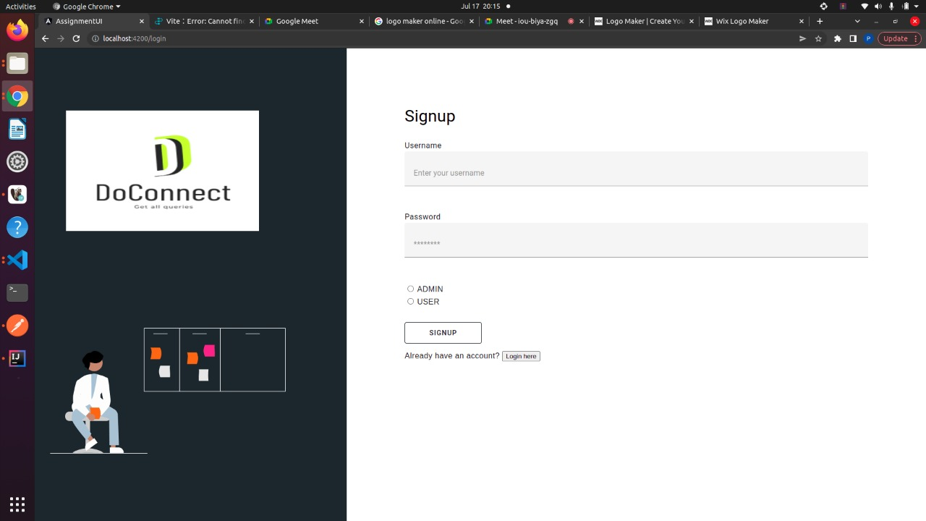
IMPLEMENTATION

Slide 14
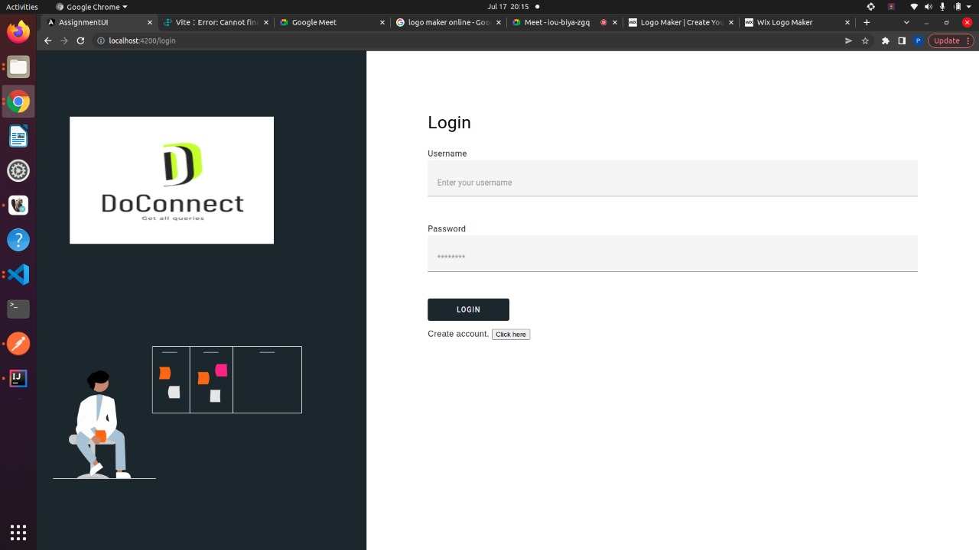

Slide 15
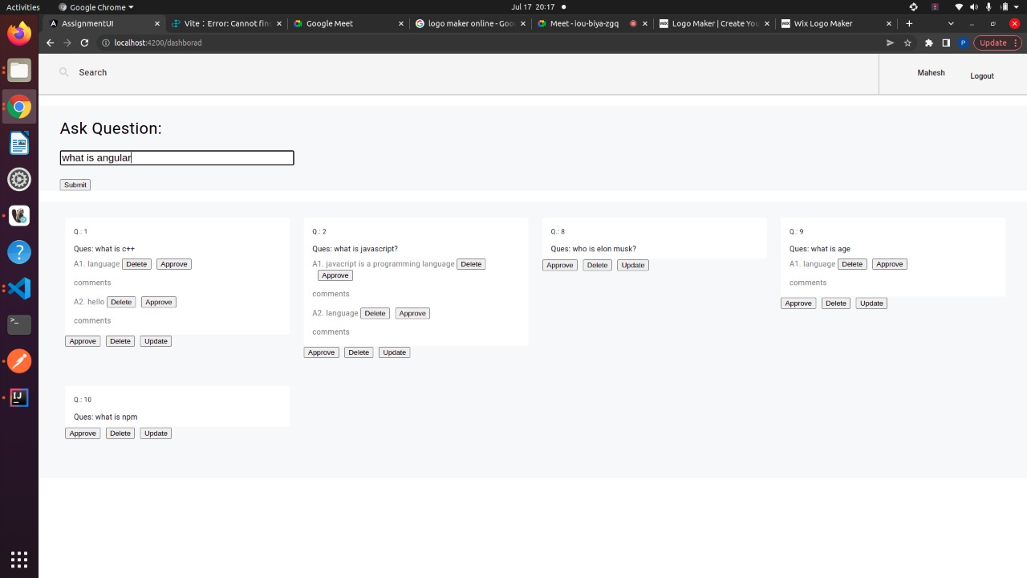

Slide 16
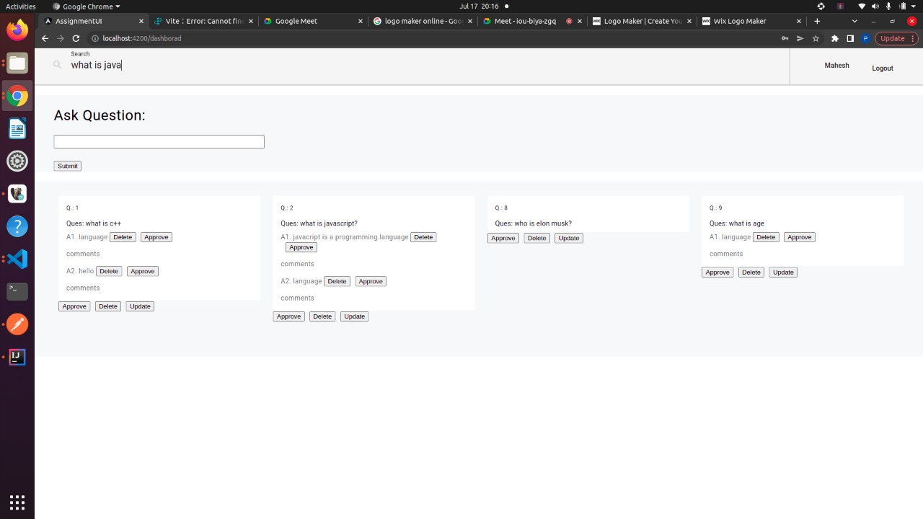

Slide 17
CONCLUSION
DOCONNECT app helps users to ask questions and answer them multiple times and Admin can control over the Q&A.

Slide 18
THANK YOU

